Slide 1
Trial Information for
GOL Transportes Aéreos

Slide 2
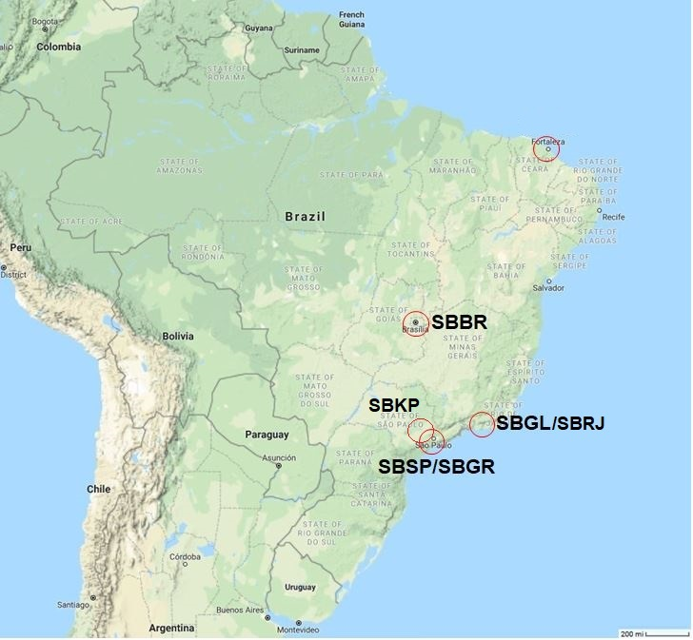
Trial Airports for GOL Transportes Aéreos
DNKN
SBFZ
SBBR
SBGL
SBSP/SBGR
1

Slide 3
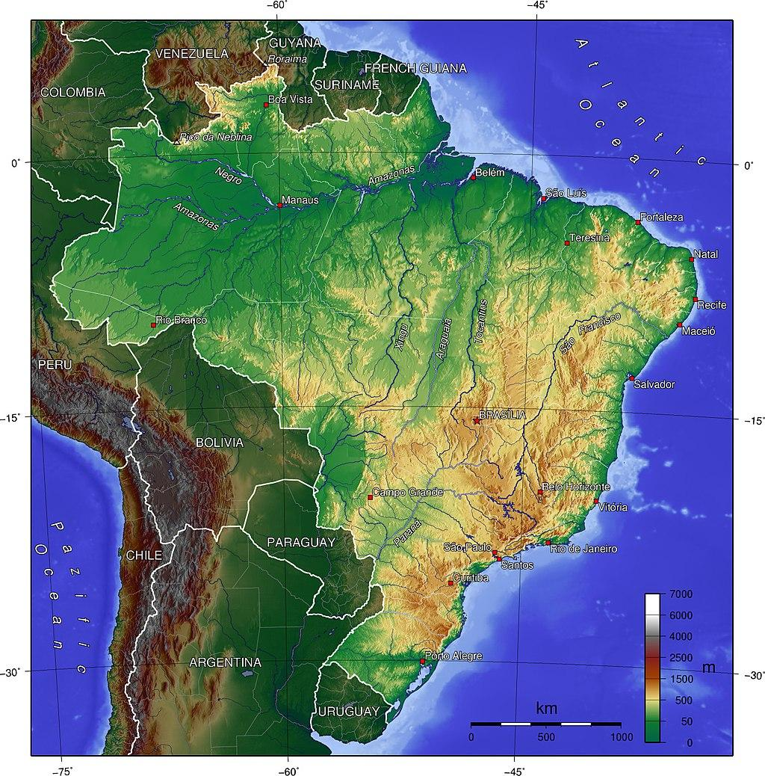
The Geography of Brazil
Geographical map with elevation for Brazil
2

Slide 4
The Geography of Brazil
Including its Atlantic islands, Brazil lies between latitudes 6°N and 34°S, and longitudes 28° and 74°W. Brazil is the fifth largest country in the world, with a total area over 8.5 million km², including 55,455 km² of water. The topography is diverse with much of the terrain lying between 200 meters (660 ft) and 800 meters (2,600 ft) in elevation. The main highland area occupies most of the southern half of the country. The northwestern parts of the plateau consist of broad, rolling terrain broken by low, rounded hills. The southeastern section is more rugged, with a complex mass of ridges and mountain ranges with elevations of up to 1,200 meters (3,900 ft). These ranges include the Mantiqueira and Espinhaço mountains and the Serra do Mar.
In the north, the Guiana Highlands form a major drainage divide, separating rivers that flow south into the Amazon Basin from rivers that empty into the Orinoco River system, in Venezuela, to the north. The highest point in Brazil is the Pico da Neblina at 2,994 meters (9,823 ft), and the lowest is the Atlantic Ocean.
Brazil has a dense and complex system of rivers, with eight major drainage basins, all draining into the Atlantic.
Major rivers include the Amazon (the world's second-longest river and the largest in terms of volume of water), the Paraná and its major tributary the Iguaçu, the Negro, São Francisco, Xingu, Madeira and Tapajós rivers.
3

Slide 5
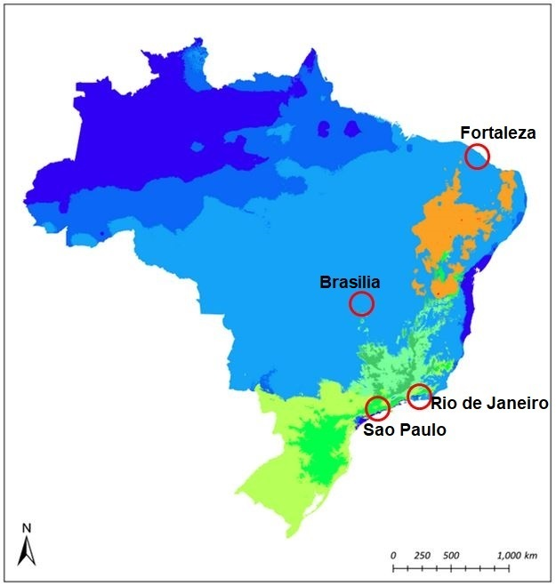
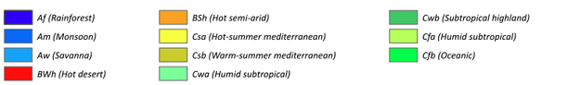
The Climate of Brazil
Climatological map for Brazil
4

Slide 6
The Climate of Brazil (Temperature)
Although most of Brazil lies in the tropics, more than 60 percent of the population live in areas cooled either by altitude, sea winds or polar fronts. While the coastal cities of Rio de Janeiro, Recife and Salvador can get extremely hot, plateau cities such as São Paulo, Brasília and Belo Horizonte have mild climates, and the southern cities of Porto Alegre and Curitiba have mild winters, but while Curitiba has a warm summer due to the average elevation of 934.6 meters (3,066 ft), Porto Alegre has a hot summer, with an average elevation of only 10 meters (33 ft).
The Amazon rarely sees temperatures of more than 32 °C (90 °F). The annual average temperature in the region is 22 to 26 °C (72 to 79 °F), with not much variation between the warmest and the coldest months. The hottest part of Brazil is the northeast, where temperatures of more than 38 °C (100 °F) are common during the dry season (May to November.
Along the Atlantic coast from Recife to Rio de Janeiro, average temperatures range from 23 to 27 °C (73 to 81 °F). Inland, on higher ground, temperatures are lower, ranging from 19 to 21 °C (66 to 70 °F). South of Rio the seasons are more defined and the range of temperatures significantly wider, with the annual average falling between 17 and 19 °C (63 and 66 °F).
5

Slide 7
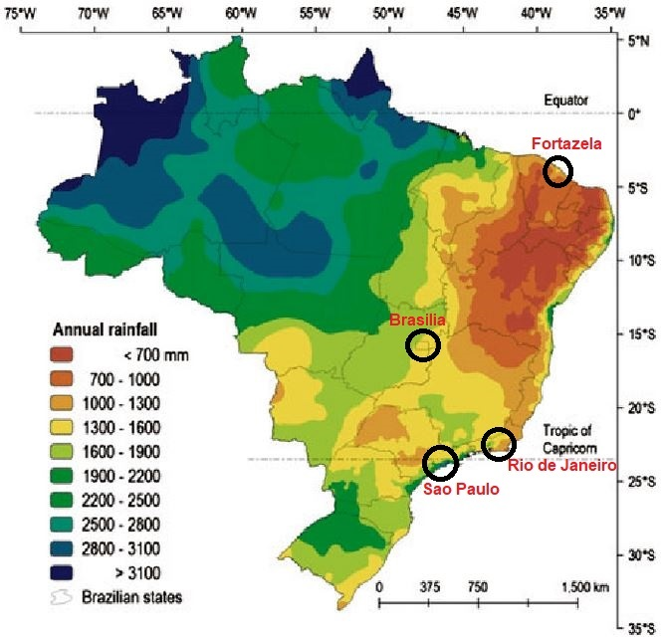
The Climate of Brazil (Precipitation)
Brazil's most intense rain falls around the mouth of the Amazon near the city of Belém, and also in the upper regions of Amazonia where more than 2,000 millimeters (79 in) of rain fall every year.
Most of Brazil has moderate rainfall of between 1,000 and 1,500 millimeters (39 and 59 in) a year, most of it coming between December and April.
The driest part of the country is the northeast, where rainfall is erratic and the evaporation rate very high, making it difficult to grow crops.
Total Annual Rainfall in Brazil
6

Slide 8
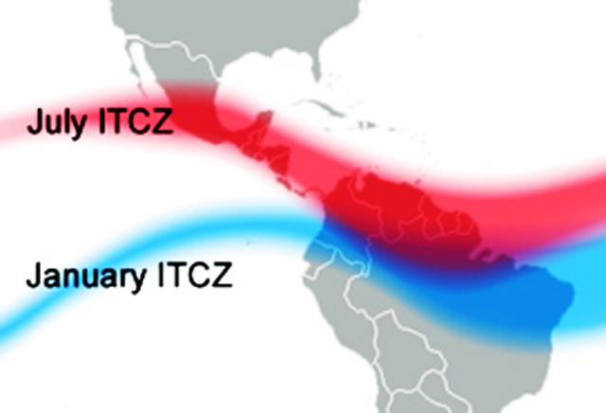
Seasonal location of the ITCZ
ITCZ locations in July vs January
7

Slide 9
Local Geography,
Climatology and
Airport Characteristics

Slide 10
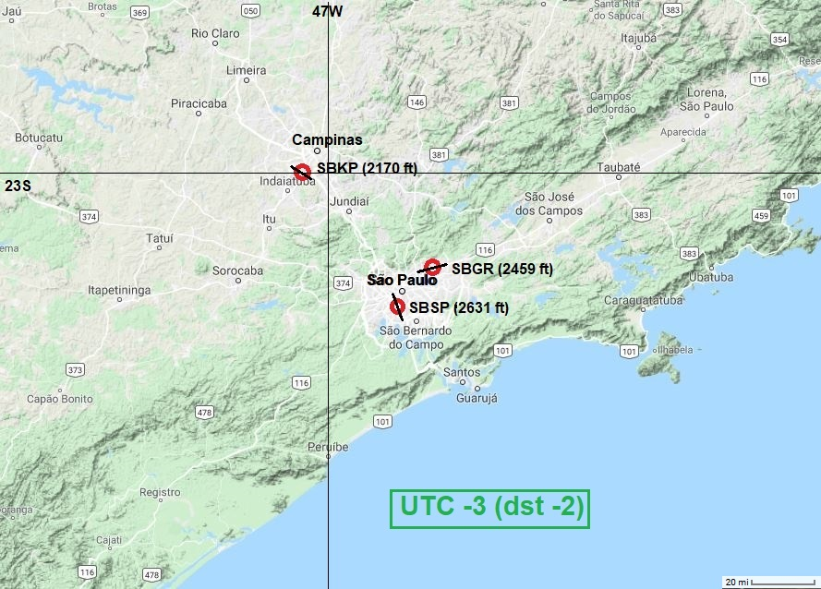
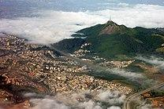
Sao Paulo Geography
Jaragua Peak is the highest point in the city, at 1,135 meters (3,724 ft).
Geographical characteristics:
São Paulo is located on a plateau just inland from the "Coastal Range" (Serra do Mar), part of the vast region known as the Brazilian Highlands, with an average elevation of near 800 meters (2,625 ft) above sea level, and only about 70 kilometers (43 mi) from the Atlantic Ocean. Rolling terrain prevails within the urbanized areas of São Paulo except in its northern area, where the Serra da Cantareira Range reaches elevations of 1,000-1,400 meters (3,500-4,500ft) and higher.
8

Slide 11
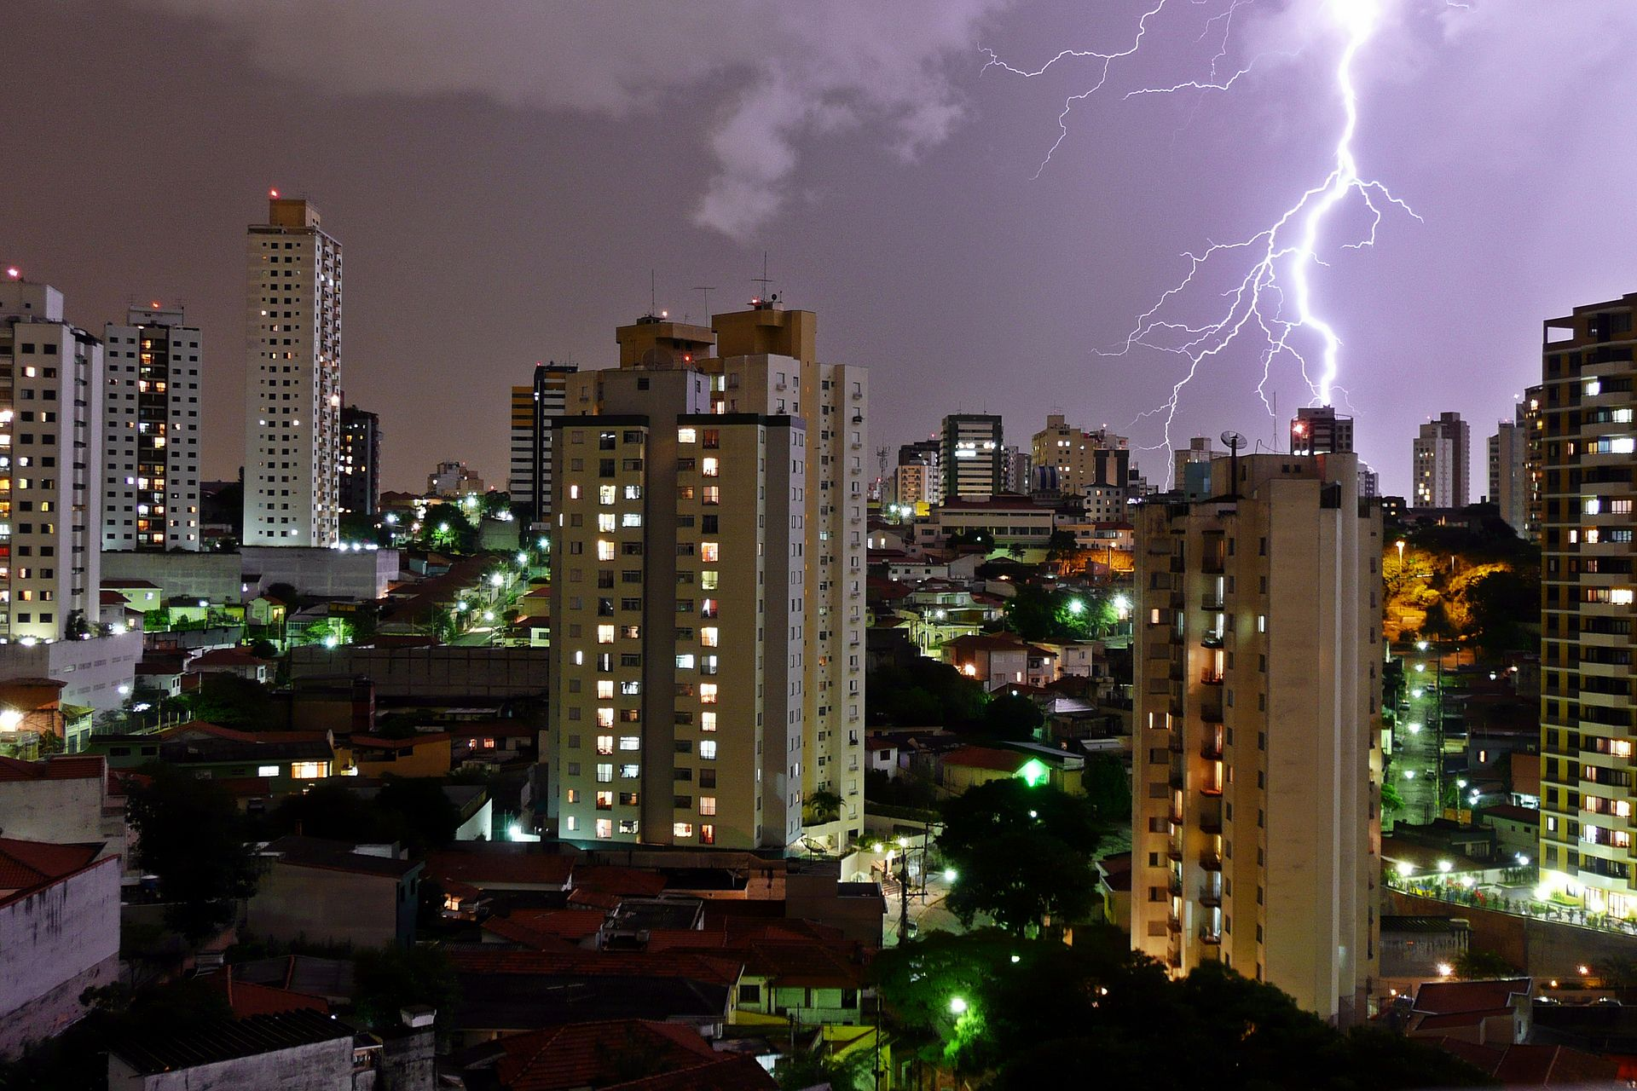
Sao Paulo Climate
Climatological characteristics:
The city has a humid subtropical climate. In summer (January through March), the mean low temperature is about 19°C (66°F) and the mean high temperatures is near 28°C (82°F). In winter, temperatures tend to range between 12 and 22°C (54 and 72°F). The Tropic of Capricorn, at about 23°27' S, passes through north of São Paulo and roughly marks the boundary between the tropical and temperate areas of South America. Due to
São Paulo has the highest frequency of lightning strikes among Brazilian state capitals.
its elevation, however, São Paulo experiences a more temperate climate.
Rainfall is abundant, annually averaging 1,454 millimeters (57.2 in). It is especially common in the warmer months averaging 219 millimeters (8.6 in) and decreases in winter, averaging 47 millimeters (1.9 in). Heavy rain and lightning are not uncommon in São Paulo, due to the frequency of wintertime polar cold fronts and summertime airmass thunderstorm activity. Thunderstorm activity is most frequent in the warmer months from October through March.
9

Slide 12
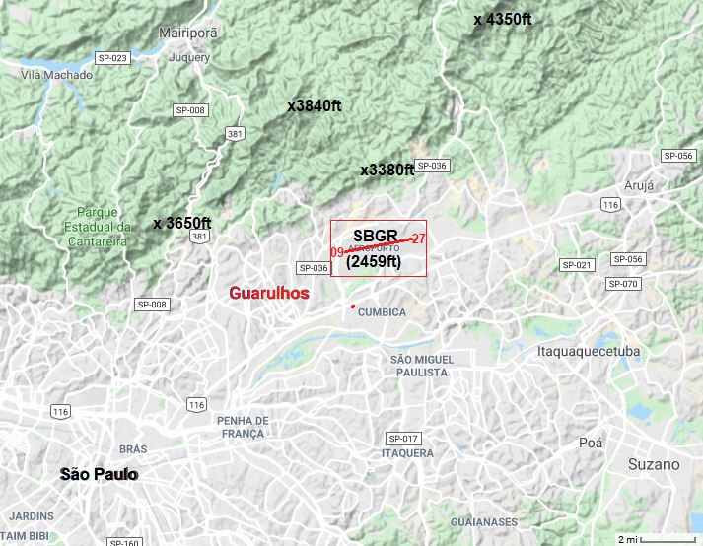
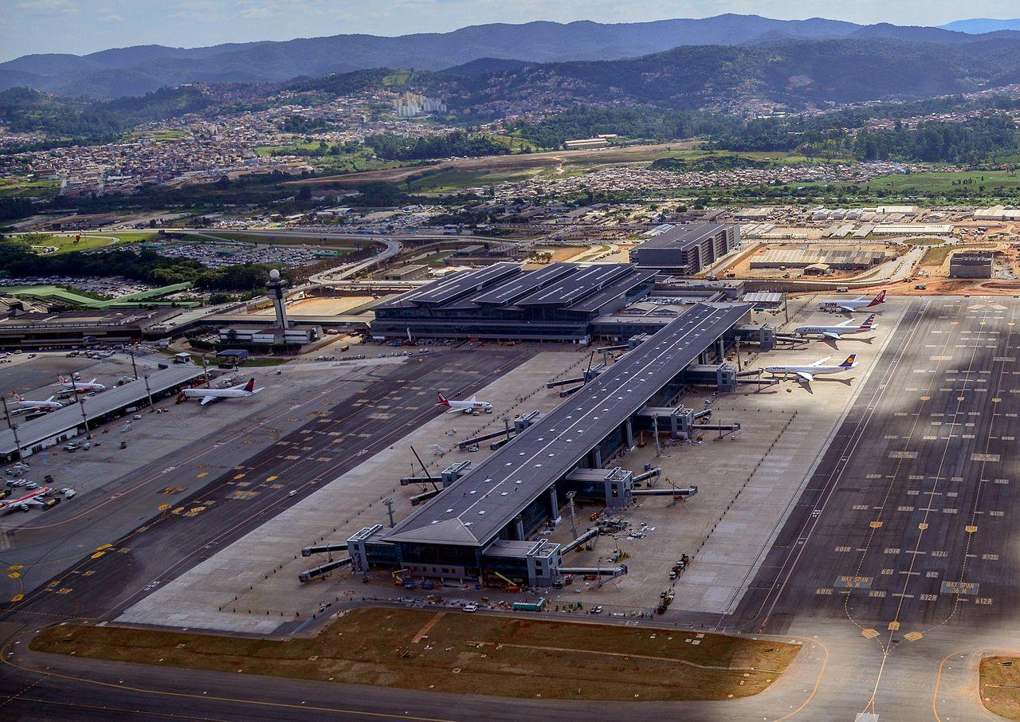
SBGR-Guarulhos Airport Characteristics
Airport characteristics:
The airport is located near the Forests of the Cantareira Mountains in a permanent marsh region between the Baquirivu-Guacu and Tiete Rivers. This aids in development of radiation fog, especially in the colder season from April to September, during the presence of the South Atlantic subtropical high.
The east-west runway is conducive to northerly crosswinds which can see
accelerated velocities coming off higher elevations near to the north of the airport.
These mountains also aid in providing lift during hours of daytime heating, with airmass Thunderstorms common in the summer months and cold-frontal shower activity in the wintertime.
SBGR-View toward NW
10

Slide 13
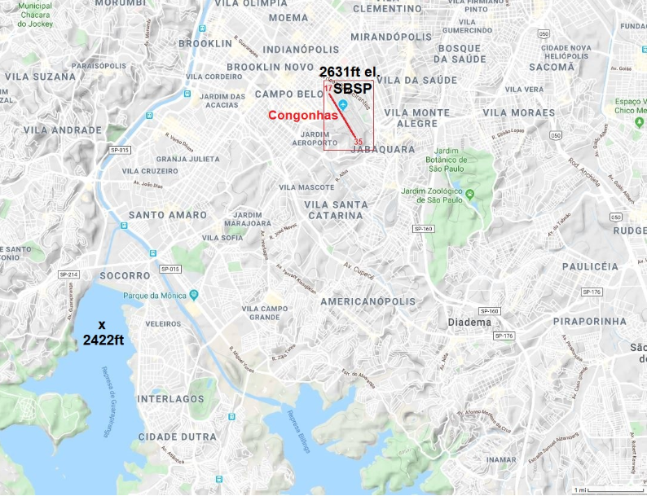
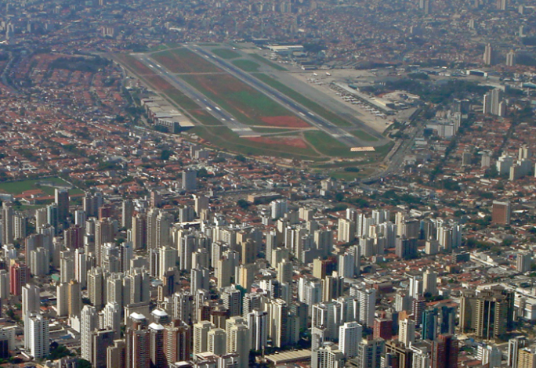
SBSP-Congonhas Airport Characteristics
Airport characteristics:
The airport is located within the city of Sao Paulo, about 7 kilometers (4.5 miles) north of two reservoirs (Billings and Guarapiranga). This location keeps temperatures generally milder than outlying areas due to the heat-island effect, but moisture advection on southerly winds from the reservoirs can enhance occasional radiation fog development, especially during the colder months from April to September and with the presence of the South Atlantic subtropical high.
The airport, like others in the area, experience highest frequency of thunderstorms during the warmer months of October through March, due to daytime heating of the airmass, and enhanced lift around area mountains but elevated convective activity can occur in the colder months, due to cold-frontal activity.
SBSP-View toward South
11

Slide 14
Campinas Geography (SBKP)
Campinas is the third largest city in the State of Sao Paulo, located 96 km (60 mi) northwest of the city of São Paulo, at an elevation of 686 meters (2,251 ft) above sea level. The city is in a part of the Brazilian Highlands, with mountains ranging from 1000-2000 meters (3300-6500 ft). Air moving across the area from west to east is lifted orographically, creating enhancement in precipitation over the area.
12

Slide 15
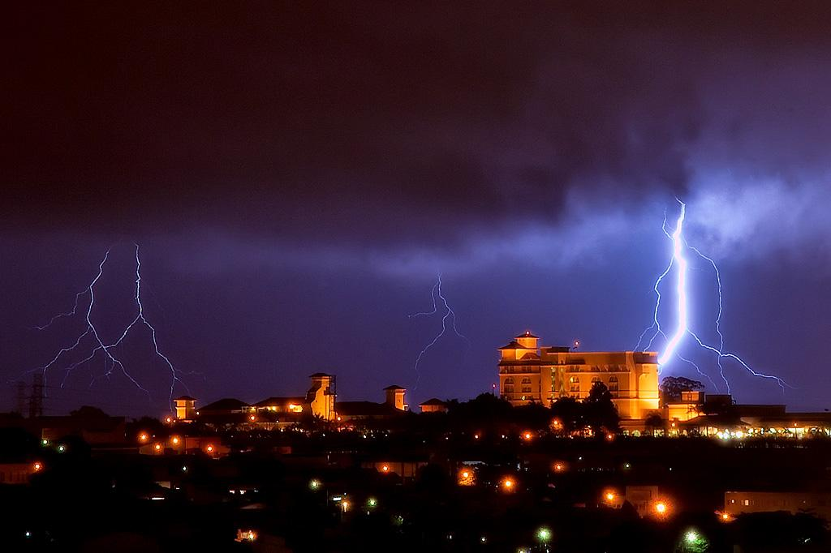
Campinas Climate (SBKP)
Climate:
Much like São Paulo, 60km to the south, the climate of Campinas can be classified as subtropical but is generally more temperate, due to its elevation at the edge of the Brazilian Highlands. The summers are long, warm, muggy, wet, and mostly cloudy and the winters are short, mainly dry and comfortable, and mostly clear.
View of Campinas during a storm.
Over the course of the year, the temperature typically varies from 13-29°C (55-85°F) and is rarely below 9°C (48°F ) or above 33°C (92°F). Heavy showers/thunderstorms are not uncommon, most frequently occurring in warmer months, due to daytime airmass heating, and enhanced by vertical motions due to the area’s higher elevations. The average annual rainfall is 1425 mm and the driest month is August, when there is only 24 mm. In January (the rainiest month) the average is 280 mm. The wet season is from mid-October to mid-April, with heaviest precipitation potential from December to March, and the dry season is from May to September.
Average humidity ranges from 37% (August) to 56% (January). During the dry season/ and other dry periods, fires in the hills and thickets contribute to worsening air quality, which can restrict visibility for periods of hours or days at a time.
13

Slide 16
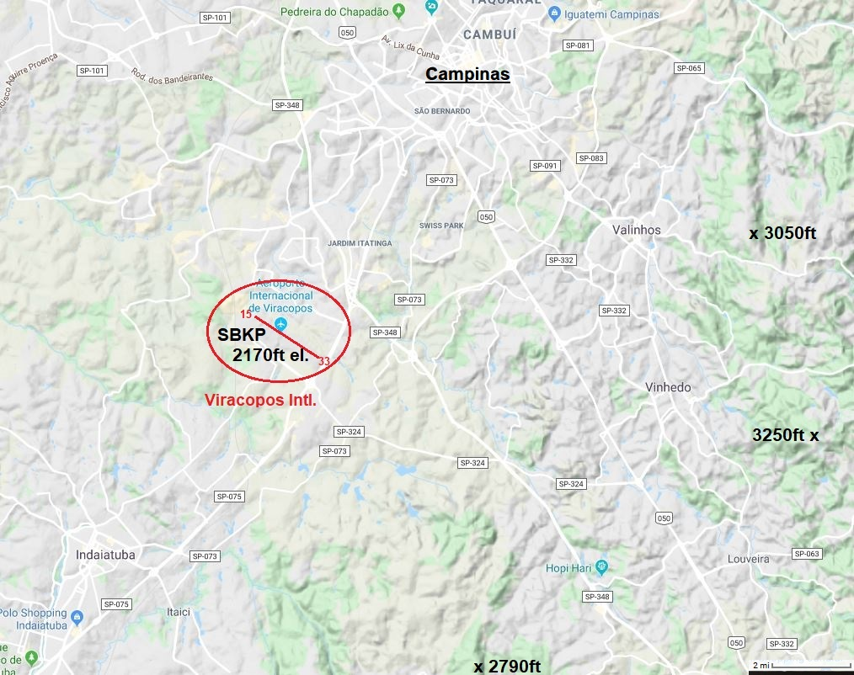
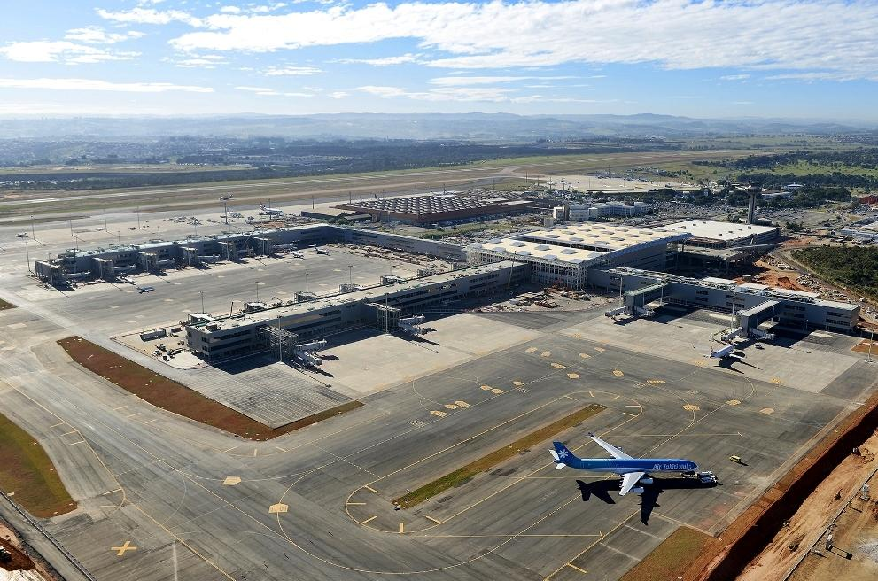
SBKP-Viracopos Airport Characteristics
SBKP is an international airport located in the outskirts of Campinas, in the State of Sao Paulo, Brazil. The airport, like others in the area, experience highest frequency of thunderstorms during the warmer months of October through March, due to daytime heating of the airmass, and enhanced lift around area mountains but elevated convective activity can occur in the colder months, due to cold-frontal activity from the south. Winds moving from west to east are orographically lifted due to higher elevations to the east & southeast.
This upslope flow toward the mountains enhances cloud and precipitation development, as well as thunderstorms. Airport temperatures are generally milder than outlying areas due to the heat-island effect but on southerly winds, moisture advection from two large reservoirs can aid in occasional radiation fog development, especially during the colder months from April to September and with the presence of the South Atlantic subtropical high.
SBSP-View toward South
14

Slide 17
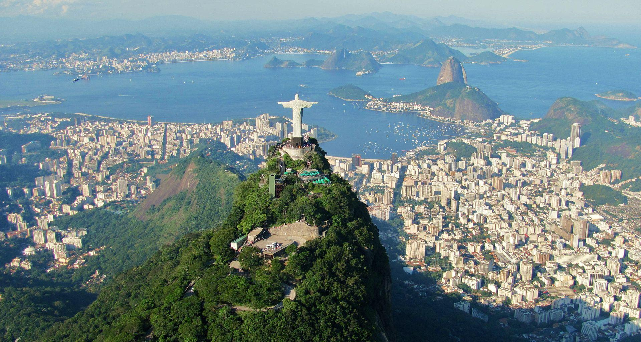
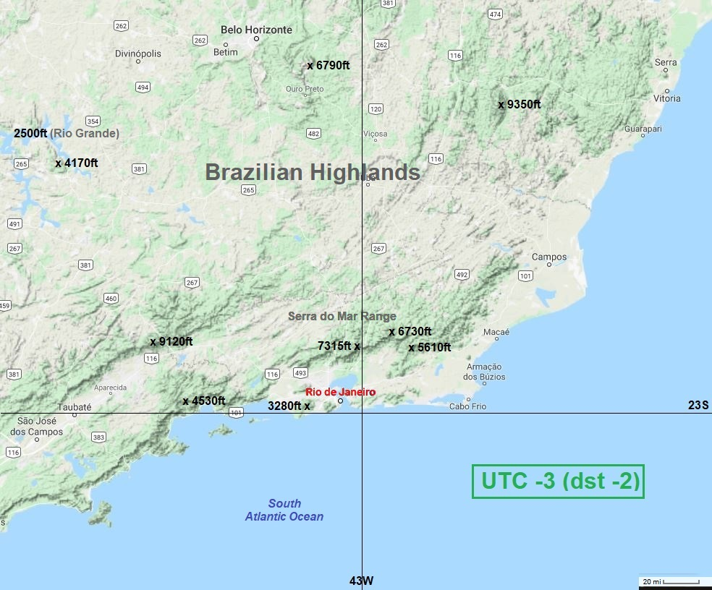
Rio de Janeiro Geography
Panoramic view of the statue at the top of Corcovado Mountain with Guanabara Bay
Rio de Janeiro is located close to the Tropic of Capricorn at 22°54’ south latitude and 43°12’ west longitude. Rio City is also the capital of the Rio de Janeiro State which lies in the south eastern region of Brazil. The Atlantic Ocean is to the south of the city, with Guanabara Bay bordering to the east and Sepetiba Bay to the west. The greater portion of the city extends to the NW on plains and hills with several rocky mountains. The southern zone of the city reaches the beaches fringing
the open sea and is cut off from the central and north zones by coastal mountains. These mountains and hills are offshoots of the Serra do Mar mountain chain that forms the southern slopes of the Brazilian Highlands. Mountains around the city range from 900 to over 2200 meters (3000 to over 7000 feet).
15

Slide 18
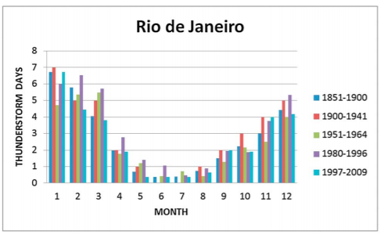
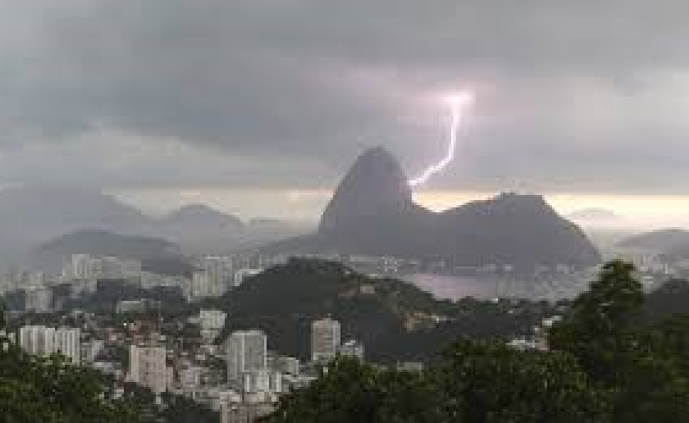
Rio de Janeiro Climate
Climate: Located on the South Atlantic Ocean and surrounded by forested land near to the Tropic of Capricorn, Rio de Janeiro has a tropical climate. Most of the year, the climate is warm and humid with exceptions due to elevation, vegetation and proximity to the ocean. Occasionally temperatures can reach as high as 40°C but mostly they hover around 30°C. Regions which are near the sea are somewhat cooler due to the ocean winds. Average annual rainfall varies from 1,200 to 2,800 mm. temperature bearable.
Average monthly thunderstorm
days for the city of Rio de Janeiro
Thunderstorm activity increases during the warmer summer months from November through March, with occasional heavy precipitation events. Because of its geographic situation, the city is often reached by cold fronts advancing from Antarctica during autumn and winter, causing frequent weather changes. Along the coast, the breeze, blowing onshore and offshore, moderates the temperature.
16

Slide 19
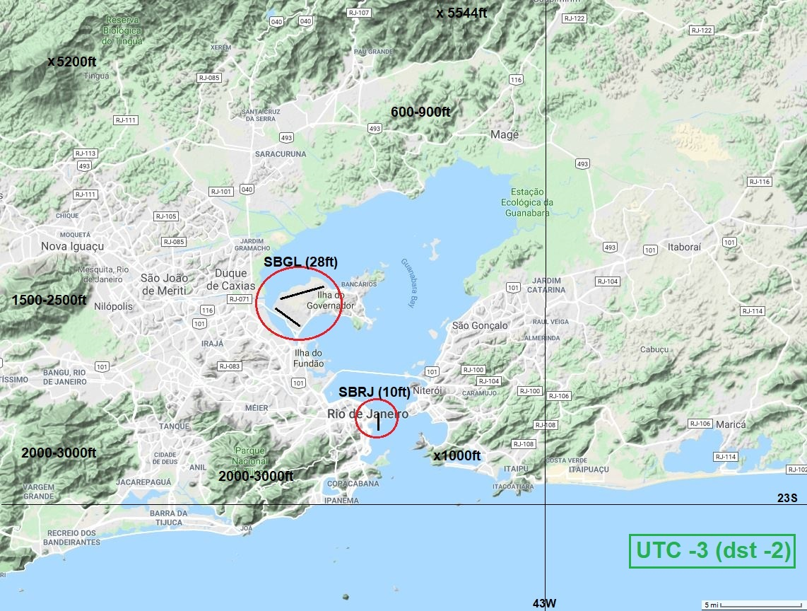
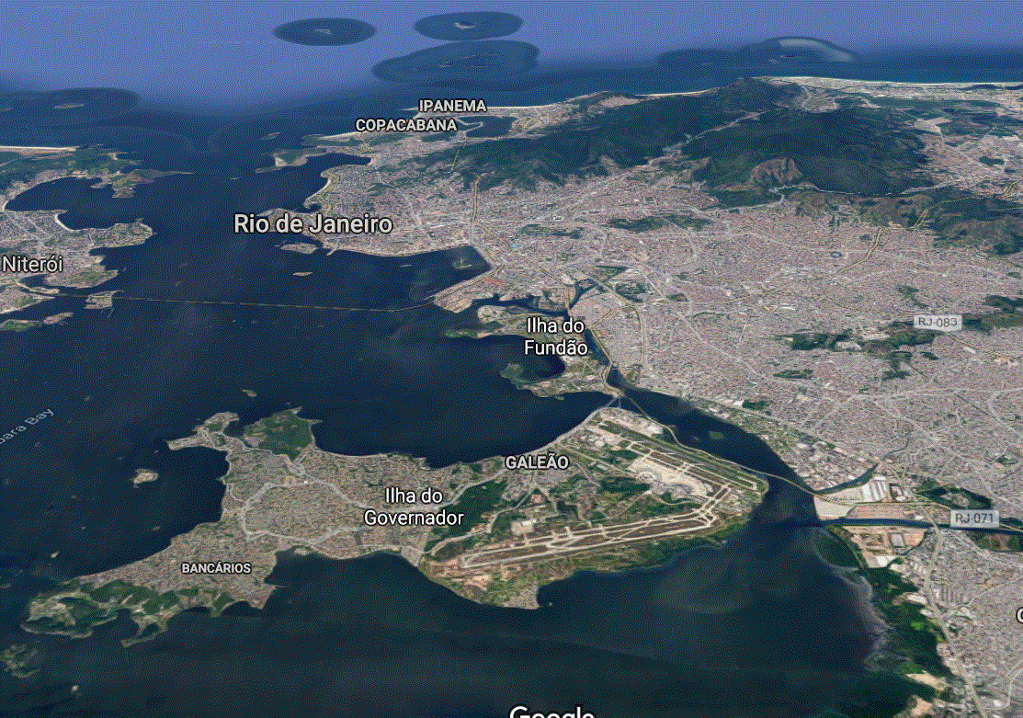
SBGL-Galeao Airport Characteristics
SBGL view toward south
subsident high pressure and light winds in the cooler mornings of June through August, fog can develop over the airport due to radiational cooling as well as moisture advection off the Bay. Winds are most commonly from the E/SE due to the easterly trade winds; however, if synoptic flow brings in a W/SW flow, moderate-to-strong winds may occur due to funneling between areas of higher terrain to the W and SW.
SBGL (Galeao Airport) is the primary airport serving the Rio de Janeiro area, located just to the north of downtown Rio de Janeiro and is surrounded by the Guanabara Bay. Due to the tropical environment, the primary severe weather threat is thunderstorms, which occur most frequently during the warmer months of December through March. During periods of
17

Slide 20
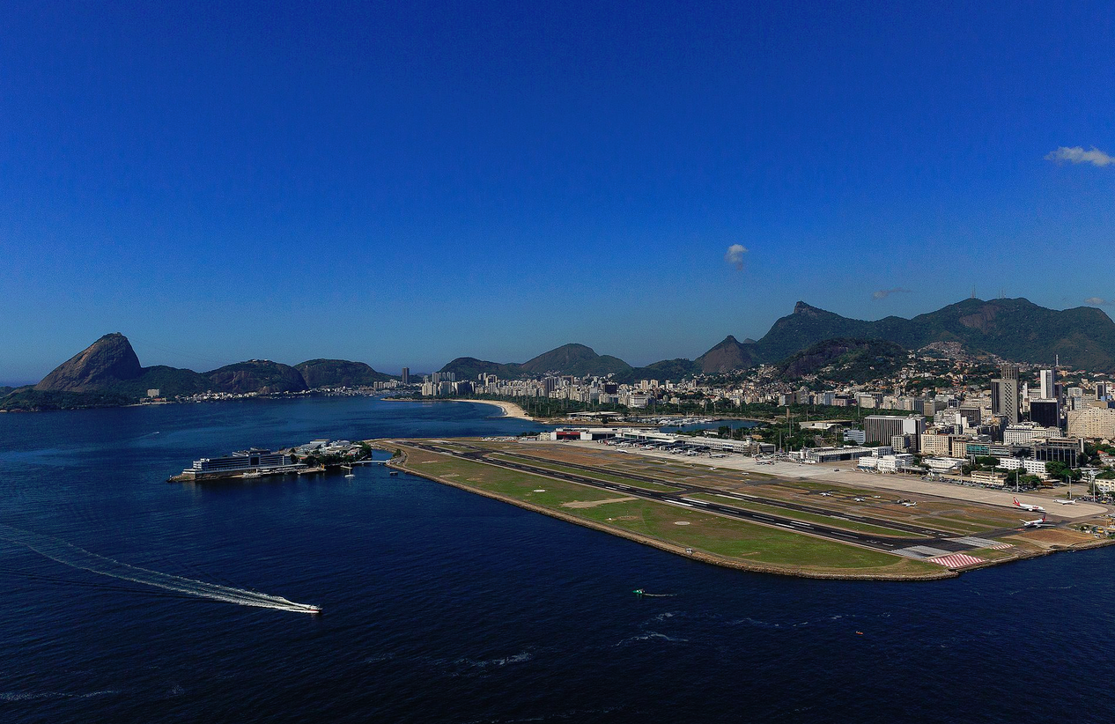
SBRJ-Santos Dumont Airport
Aerial view of SBRJ with view toward SW
SBRJ (Santos Dumont Airport) lies 12 km (7.5 mi) to the southeast of SBGL, near the entrance to Guanabara Bay. Winds are most commonly from the E/SE due to the easterly trade winds; however, if synoptic flow brings in a S/SW’erly flow, moderate-to-strong winds may occur due to compressional funneling between areas of higher terrain surrounding the entrance to the Bay. Located within the subtropics of the Southern Hemisphere, the primary severe weather threat is thunderstorms, which occur most frequently during the spring/summer months of December through March.
18

Slide 21
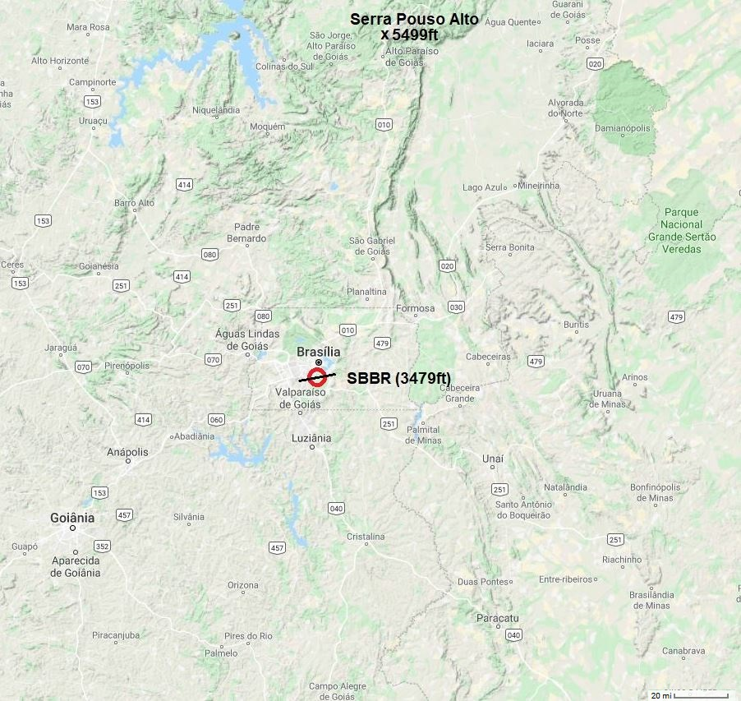
SBBR – Brasilia Geography and Climate
Characteristics:
Brasilia Intl Airport is located about 450 miles inland from the South Atlantic Ocean at the top of the Brazilian highlands in the country's center-western region. The Paranoá Lake, just northeast of the airport is a large artificial lake that maintains humidity over the area, with infrequent fog development during cooler, mornings with a northeasterly breeze. There is a tropical savanna climate with distinct dry and wet seasons (Rainy Season from October-April & drier from May-September). However, haze due to pollution and smoke from the Amazon can occasionally reduce visibility.
State of Goias, Federal District-Brasilia
Higher terrain surrounding the airfield typically holds temperatures within mild ranges, with the average annual high 26.6 °C (79.9 °F) and average low 16.8 °C (62.2 °F). Airmass Thunderstorms are common in the summer.
19

Slide 22
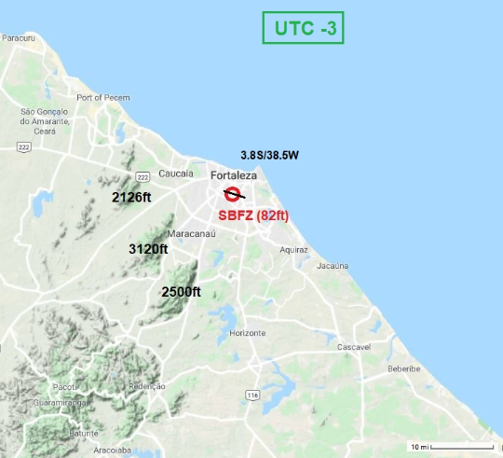
SBFZ - Fortaleza Geography
Geographical characteristics:
Fortaleza Intl Airport, on the northeastern coast of Brazil in the State of Ceara, is located at 3.8S/38.5W deg. south latitude. The airport lies within the region of the southward (January to June) fluctuation of the ITCZ.
The coastal plain rises quickly into area mountains to the south and southwest, which enhance lifting and condensation of warm, moist winds. The area enjoys mild sea breezes and diurnal wind fluctuations due to a relatively hot and dry interior region.
State of Ceara (Fortaleza)
20

Slide 23
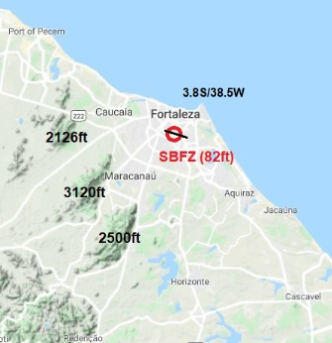
SBFZ – Fortaleza Climate
Climate Characteristics:
Fortaleza has a tropical savanna (wet and dry) climate, with high temperatures and relative humidity throughout the year, but these conditions are usually relieved by pleasant winds blowing from the ocean. Average temperatures vary little throughout the year. December is the warmest month, with a high of 30.7 °C (87.3 °F) and low of 24.6 °C (76.3 °F). The rainy season spans from January to June, with rainfall most prodigious in March and April. The average annual temperature is 26.6 °C (79.9 °F). Average relative humidity in Fortaleza is 79%, with average annual rainfall of 1,644.8 millimeters (64.75 in). There is usually rain during the first seven months of the year from January to July, with highest relative humidity. Fortaleza's climate is usually very dry from August to December, with very little rainfall.
Winds, though strong and variable around thunderstorms, can also strengthen from the south through west as they can be funneled between nearby mountains. The coastal plain rises quickly into these area mountains. This can enhance lifting and condensation of warm, moist winds, creating occasional lowering of clouds with precipitation. The area enjoys mild sea breezes and diurnal wind fluctuations due to a relatively hot and dry interior region.
21

Slide 24


